Slide 1
Relationship/Referral Marketing
How to get your customers
and friends help you
grow more business.

Slide 2
How/why I turned to Referral Marketing
I am probably the worst “in-store” marketer in CT;
Maxed out in sports side of my business;
Not many “big businesses” in my area;
Corporate is prime area to grow, and I hate/don’t do “cold calling”
Research shows we all have 250-600 people in our network (CT owners trend higher I think)
Who would you be more likely to buy them – a friend who refers someone or a cold call on the phone;
Quick Facts:
- nearly 2/3 of business owners state referrals are the majority of their business, yet 80% have NO plan on how to get referrals

Slide 3
My three-pronged, integrated Referral Marketing Strategies
1.) BNI
- $1K/year & meet weekly;
- So far $10.5K in sales in 10 months;
2.) E-mail follow up
Free, instant credibility, get’em while they love you;
3.) LinkedIn (not “Social Media”)
Free to $50/month, depending upon “package”
Referral marketing is farming,
not fishing

Slide 4
How do you learn about LinkedIn and how to use it to “mahket”?
LinkedIn is NOT social media;
I tried webinars and CD training “modules”;
Nothing “clicked” for me;
I couldn’t find any seminars or classes near me to learn;
A sales professional friend showed me “how to”
- It worked! So that’s what I’m going to show you

Slide 5
LinkedIn The premise/inherit assumption is that you agree to “link” people
A 1st level connection is someone you have a relationship with (or you’ve accepted them as a friend)
A 2nd level connection is a friend of a friend, and a 3rd level connection is a friend of a friend of a friend (3rd levels are pretty useless for our purposed);
Be “legit” when adding people to your network (don’t be a friend with people you don’t know);
The benefits of using LinkedIn to market?
You can drive by a building and then see if you have any connections there;
You can see if your friends, old colleagues, and existing customers can “link/connect” you to someone you want to meet;
Remember that the end result is a phone call or meeting

Slide 6
Suggestions on using LinkedIn
LinkedIn shouldn’t replace face-to-face interactions, is just shortens the cycle to get to that result;
While LinkedIn has an email-type function (think of Messenger on Facebook), it’s not very dependable
Use “real” email whenever you can;
Send you “connector” an email on how to introduce you; keep them in the loop on how it’s going;
Some people are intimidated by what to state about you, so if you supply them with the text, they can cut/paste/tweak – much less stressful for them AND you can write your intro and get YOUR points across

Slide 7
Steps to work LinkedIn for Marketing Purposes (screen shots follow)
1.) In the upper left search bar (next to IN, type in name of the company you’re trying to reach
2.) You will get a list of people that you are “connected to” and what level the connection is (1st, 2nd, 3rd, etc.)
3.) click on the person’s name in blue (this will show you mutual connections0

Slide 8
Steps to work LinkedIn for Marketing Purposes (screen shots follow)
4.) The person’s bio appears
5.) You can view their Bio and/or connect with them right below their info
6.) on the lower left of this page you can see your mutual “connections”
You are on your way to making GREAT connections!!!

Slide 9
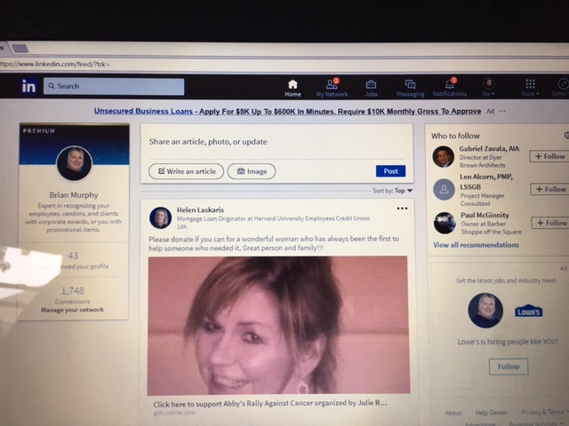

Slide 10
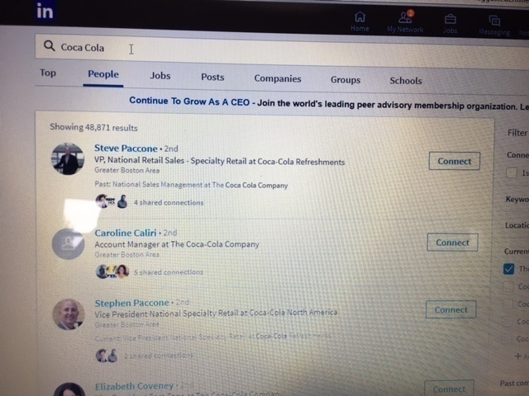

Slide 11
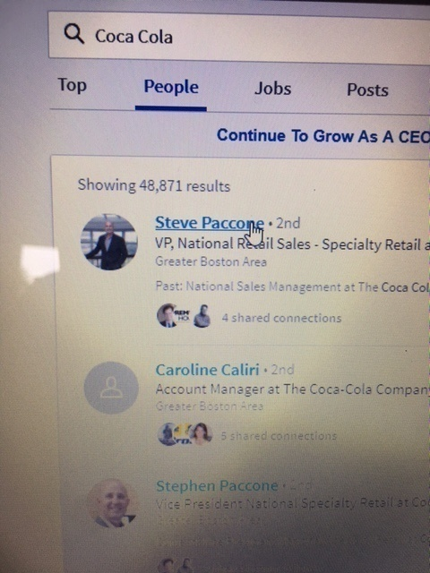

Slide 12
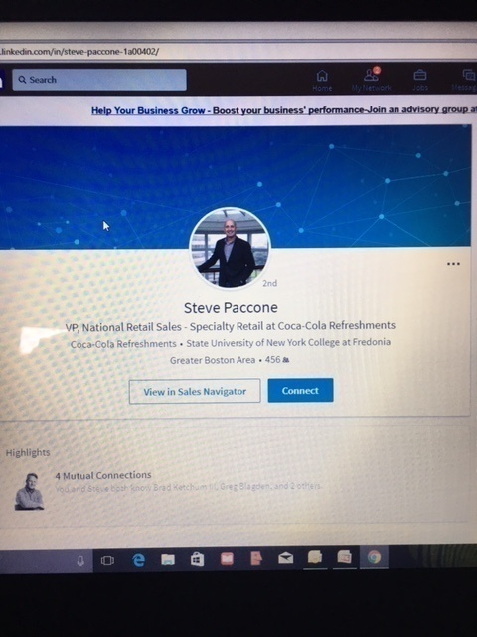

Slide 13
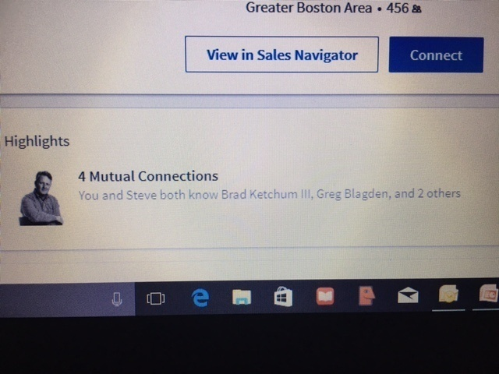

Slide 14
Follow is key
48% of sales people don’t follow up;
25% follow up just once;
12% make three contacts and stop;
Only 10% make more than three contacts;
Only 2% buy on 1st contact, 3% of 2nd contact, 5% on 3rd, and 10% on 4th
80% of sales are made on the 5th-12th conctact!

